Slide 1
Chapter 6
Database security

Slide 2
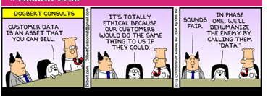

Slide 3
Security layers

Slide 4
Database security
Motivation: recent incidents
Functions
Relational databases
Attacks
Unit of protection
Defenses
Evaluation

Slide 5
Hacks cost Yahoo $700 million SANS NewsBites Vol. 19 Num. 015
Ars Technica reports that Verizon and Yahoo have agreed a price tag of about $4.48 billion for the company. The $350 million cut is the result of Yahoo’s recent disclosure of not one but two enormous security breaches.
The breaches compromised 1.5 billion user accounts and the investigation that followed (three years later) led forensic experts to express concerns that users’ accounts may also have been accessed using forged cookies.
Not only did Yahoo's security breach cause Verizon to reduce by $350M what they were willing to pay for Yahoo's Internet business, but Yahoo also had to agree to pay for 50% of any future costs. That essentially means Yahoo's failures in security cost the company at least $700M in revenue from the sale and that is on top of the costs they have already incurred in dealing with the breach, which likely at least doubles the impact -- a $1.5B hard cost.

Slide 6
Hackers Took Fingerprints of 5.6 Million U.S. Workers http://www.nytimes.com/2015/09/24/world/asia/hackers-took-fingerprints-of-5-6-million-us-workers-government-says.html?hp&action=click&pgtype=Homepage&module=first-column-region&region=top-news&WT.nav=top-news
WASHINGTON — Just a day before the arrival of President Xi Jinping for a meeting with President Obama that focused heavily on limiting cyberespionage, the Office of Personnel Management said that the hackers who stole security dossiers from the agency also got the fingerprints of 5.6 million federal employees.
Customs and immigration officials frequently fingerprint incoming travelers; millions of fingerprints in a Chinese database would help track the true identities of Americans entering the country.
Hackers did not just get the data on federal employees, but also on job applicants, contractors and many others who have been subjected to government background checks.

Slide 7
Medical records breach 09/08/11
A medical privacy breach led to the public posting on a commercial Web site of data for 20,000 emergency room patients at Stanford Hospital in Palo Alto, Calif., including names and diagnosis codes, the hospital has confirmed. The information stayed online for nearly a year.
The hospital has been investigating how a detailed spreadsheet made its way from one of its vendors, a billing contractor identified as Multi-Specialty Collection Services, to a Web site called Student of Fortune, which allows students to solicit paid assistance with their schoolwork.
Even as government regulators strengthen oversight by requiring public reporting of breaches and imposing heavy fines, experts on medical security said the Stanford breach spotlighted the persistent vulnerability posed by legions of outside contractors that gain access to private data.
The spreadsheet included names, diagnosis codes, account numbers, admission and discharge dates, and billing charges for patients seen at Stanford Hospital’s emergency room during a six-month period in 2009. It did not include Social Security numbers, birth dates, or credit-card numbers.

Slide 8
Premera attack ---Tom Henderson http://www.networkworld.com/article/2899073/security0/premera-hack-another-sign-that-data-in-the-u-s-is-under-attack.html?phint=newt%3Dnetworkworld_security_alert&phint=idg_eid%3Dc30d380502694c47d2c45cb7576fbd6b#tk.NWWNLE_nlt_security_2015-03-19
Eleven million users of Premera Blue Cross insurance will likely get free credit monitoring for a year, as this were somehow recompense for bad security, inept IT, bad asset management, and insulting the dignity of their clientele. And this is not the end.
Even when healthcare data is used legally, we have no standards, and privacy standards are largely an oxymoron. Add the legal use/misuse, the stolen data, and the future doesn't look very bright. Worse: don't expect government intervention to do much.

Slide 9
Data breach at Anthem 2/6/15
Anthem is one of the largest US health insurers
The hackers gained access to up to 80 million records that included Social Security numbers, birthdays, addresses, email and employment information and income data for customers and employees, including its own chief executive.
The hackers are thought to have infiltrated Anthem’s networks by using a sophisticated malicious software program that gave them access to the login credential of an Anthem employee.
They did not encrypt their database
The combination is enough for some of Anthem’s customers to become victims of identity theft or email phishing schemes. Stolen medical information could also be used to make false insurance claims.

Slide 10
Data Breaches by the Numbers Wade Williamson on August 31, 2015 http://www.securityweek.com/data-breaches-numbers
The Privacy Rights Clearinghouse has maintained a searchable database of breaches from 2005 to the present, allowing us to track the rise and fall of data breaches.
The table below shows year-over-year trends of breach data from 2013 through August 2015. I picked 2013 as a starting point because it includes the Target breach, which marked the beginning of a series of massive data breaches that continues today.
Additionally, we took advantage of the PRC’s database to analyze how the breach occurred. Known sources of a breach include hacking by external parties, disclosures by insiders, accidental disclosures, loss of physical records, as well as losses from portable devices and stationary devices like servers.

Slide 11
Data Breaches II
First, based on the number of records compromised, breaches are on the rise. In security circles, 2014 was known colloquially as “the year of the breach.” However, 2015 almost doubled the 2014 tally of breached records, and has done so in the first eight months.
Digging deeper, we can see the source of these breaches. The first thing that stands out is that external hacking is far and away the leading source of breaches, and the percentage is growing. In 2013, external hacking accounted for 83.77 percent of the total records that were compromised. In 2014, that percentage jumped to 98.73 percent. So far in 2015, the percentage continued its rise to 99.99 percent.
To reverse the trend, security teams must adopt new tools and techniques that identify breaches in real time. This means going beyond just malware to identifying all phases of a breach, including the steps of attacks that don’t use malware at all. It requires a unified and real-time understanding of an attack from reconnaissance through to the attempt to gather data for exfiltration.

Slide 12
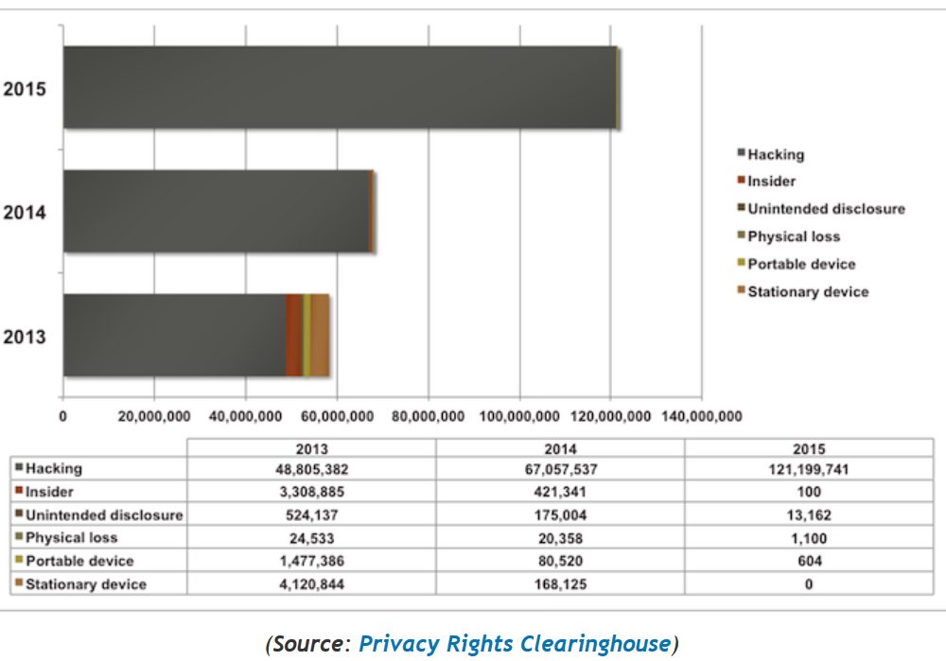
Data breaches

Slide 13
Cost of data breaches http://www.techrepublic.com/article/report-average-enterprise-data-breach-cost-rises-to-1-3m/
The cost of a data breach for enterprises in North America increased this year (2017), according to a new report from Kaspersky Lab and B2B International, released Tuesday. The total impact of a data breach now amounts to $1.3 million for large companies—up from $1.2 million in 2016, the report found. Breaches cost an average of $117,000 per incident for small- and medium-sized businesses (SMBs), the report also noted.
After surveying more than 5,000 businesses across 30 countries, Kaspersky Lab found that businesses are beginning to view IT security as a strategic investment, and are increasing security budgets in response. All companies spent 18% of their budget on IT security this year, compared to 16% last year, and this pattern was consistent across both large and small organizations. This year's increases were driven by the growing complexity of IT infrastructure, the report noted.

Slide 14
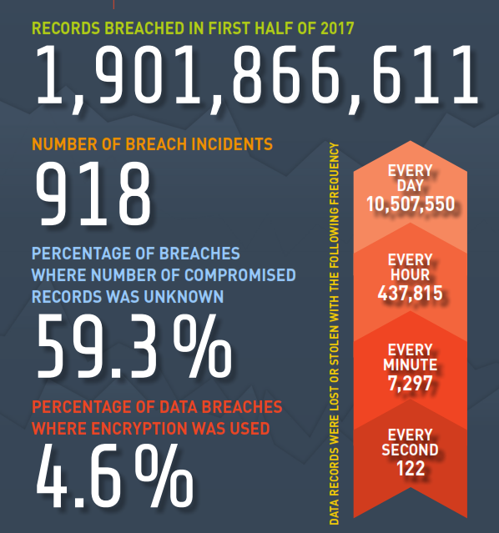
Gemalto Report 10/2017

Slide 15
Databases
A DBMS is a repository of persistent data
Query and other data handling languages
Efficient storage of information
Authorization system
Concurrency control
Recovery and fault tolerance
Notes:
Databases are usually the objective of most attacks. They contain the persistent information of the institution and this persistence gives time to the attackers to find ways to get to their information.
They are now an integral part of web services.
Typically a DMBS includes query and data handling languages, to use the information.
They are also optimized for efficient storage and search of information.
Most commercial database systems include an authorization system.
Additionally, they include a concurrency control system and mechanisms for recovery

Slide 16
Relational databases
Relational databases store their data in the form of tables, where each entry (tuple) represents a record
The relational model uses several basic (relational algebra) operations to manipulate data: selection, projection, union, minus, Cartesian product, and join
There are also rules for integrity
The basic operations can be used to define views that present the users a subset of the database
Almost all relational databases use SQL as data manipulation language (SQL is an ANSI and ISO standard).

Slide 17
Table descriptions

Slide 19
Standard architecture
Subschema's or user views present a subset of the data in different formats.
A schema or conceptual model describes the relevant model for the institution.
A storage schema describes access paths to search and retrieve data efficiently.
Mappings define the correspondence between schemas. Usually the DBMS runs on top of the OS, utilizing its services, in particular authentication and data storage (Typically, the OS files contain the DBMS data. )

Slide 21
Modules or subsystems
Storage module.
It is responsible for all the aspects of the physical storage of the data on disk or in the operating system (OS) files. It maps the logical relations into physical files. It maintains the various indexes and access methods. It is responsible for interface with the OS and the buffer (cache) management. It contains the concurrency control component which enforces locking protocols and detects deadlocks during data access. It contains the Log & Recovery components which assure the atomicity and durability of transactions and provides tools for recovery in case of system failures.
Query and DML module.
It is responsible for compiling, optimizing and executing queries and embedded DML (data manipulation language) programs. This module is responsible for storing and maintaining all the database (schema) definitions in the data dictionary. It is also responsible for parsing the SQL queries, and optimizing them using the information in the data dictionary (such as existence of indexes, selectivity of attributes, etc.).
This module also contains most of the security and integrity features. Security is usually checked by the query compiler when a view is used, and the integrity is checked partly at compile time and partly at run-time (during Update), since some values which are being updated are known only at run-time.
User-interface module.
It is responsible for the actual interface of the system to users to programs or to a host language. Standard protocols such as ODBC or JDBC may be used here.

Slide 22
Security in DBMSs
Most of the security issues are at the higher layers of the system
In most cases, a DBMS will be implemented on top of an operating system and therefore will rely on its security features
Therefore, low level security issues such as: protection of memory buffers, or separation between various threads of control are delegated to the OS, and the DBMS is not concerned with them
In addition, most DBMSs rely on the OS for user authentication, although some products (e.g. Oracle) provide their own authentication methods.

Slide 23
Views
A view enables users (or groups of users) to access only a portion of the database, thus providing both convenience and security
A view also enables conversion of logical data types into language-dependent data types depending on the host language in which the view is embedded
In all SQL based systems, a view can be defined using the standard SQL syntax.
Since all SQL syntax is available to the definer of a view, a view may be very complex and can control access to each data item
It's important to note though that a view is only a "window" on the database, and does not exist as a physical table. Thus the view has to be retrieved with every access, and therefore is always up-to-date.

Slide 24
A view definition

Slide 25
Authorization in SQL
The basic units for authorization are either a table or a view. If one wants to grant access to part of a table (some of the columns, or some of the rows), or if one like to support content-based protection, one must do it by definition of an appropriate view.
Also the administration of authorization is not central, and the creator of a table (or a view) can grant access with a Grant option to other users, thus delegating the right to define authorization distributively.
The syntax of the GRANT and REVOKE commands is the following:
GRANT privileges on Object to users [with GRANT option]
REVOKE [GRANT option for] Privileges ON Object from Users {RESTRICT
| CASCADE}

Slide 26
Privileges (rights)
Select - the right to read all columns of the object, including columns added later by an SQL Alter Table command.
Insert - the right to insert new values (tuples) into all columns of the object. If the object is a View, restrictions apply on what can be inserted, but this is dependent on the view definition and not on the authorization.
Update - the right to update all columns of the object with options similar to those of Insert.
Delete - the right to delete rows from an Object. In addition, there are two new privileges:
Usage - the right to use the current definition in other definitions.
Reference - the right to use the object in specifying Integrity constraints of other objects. Again, a specific column may be specified.

Slide 27
Roles in SQL
In SQL99, there are several features which relate to the Role-based model. There are commands for defining new roles, e.g. CREATE ROLE AUDITOR_GENERAL
Hierarchies may be defined by using a command such as:
GRANT AUDITOR TO AUDITOR_GENERAL
Permissions may be assigned to Roles by a command such as: GRANT INSERT ON TABLE BUDGET TO AUDITOR
Roles may be assigned to users or to programs by a GRANT command and a specific role may be assigned to a user at run-time

Slide 28
Database security threats
Illegal access to information. This problem can occur either by wrong authorization rules or by a user bypassing the authentication process (see next item). A database usually contains large quantities of data shared by multiple users. Access control must be defined and enforced in various granularities, and administered correctly. The risks may be due to invalid or incomplete specification of authorization, or due to lack of control on the administration of authorization.
Bypassing authentication. Database access control relies on the authentication of users. In Client/Server systems, the client machine must also be authenticated. However, generally the authentication problem is delegated to the Operating System and is usually not dealt with within the DBMS.
Attacking data in transition. Data, which is extracted from the database, and transferred to/from users, may pass through several layers. Its protection is done by the Operating and Network layers and is usually not the job of the DBMS.
Using Inference to find sensitive information. Even valid access (e.g. to aggregate data), to a database may reveal undesirable or secret information by using inference algorithms. The inference problem refers to the ability to combine statistical queries to deduce individual private information. Such inference may cause serious privacy problems. A database system should be able to protect against such inferences.
Exploitation of misconfigured databases—default accounts and configuration parameters
The web brought new routes for attacks

Slide 29
Web databases
Until now we have assumed that users and administrators interact directly with the database and therefore the use of the standard mechanisms of SQL like Views and Grant/Revoke is applied.
The situation in the Web is different. In this case, users are connected to a Web server which itself interacts with the database
In this architecture all the communication to the database is done by the web server which interacts with the users.
In contrast with the standard database architecture where there are a small number of known users who are authenticated to the DBMS at session initiation time, and where it is easy to associate transactions to the user performing them, in the Web/Database case we have the following situation:
Users are casual and unknown
The number of users is not limited
Users do not connect directly to the DB

Slide 30
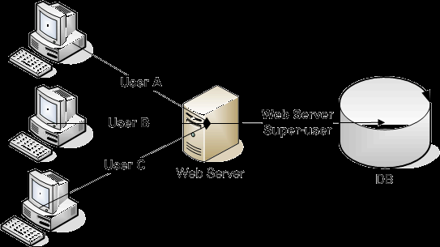
Web database architeture

Slide 31
Connection security in web servers
Often the technique of Connection Pooling is used. In this case, different web users can run their SQL statements on the same DB connection and one user can run her SQL statements on different connections. This technique contributes to application efficiency since the time to open and close the connection is saved per each request, but it has serious implications on the database’s access control mechanism.
Now, the DBMS cannot identify the real application user who accesses it, and usually the only user accessing the database is the 'user' of the web application server which has "super-user" privileges. This means that at the database level, no user-based access control and no RBAC can be applied, and the principle of least privilege is violated.
This situation would be ok if web applications would have been written by security experts, but this is often not the case and as a result the web application and the database itself are very vulnerable.

Slide 33
SQL injection attack
This attack happens when a web application displays a web page to the user asking him to fill various parameters. These parameters are transferred to the Web server by an HTTP Get or Post command, and the Web server in turn fetches these parameters and insert them into an SQL template which exists in the application, and then sends the resulted dynamic SQL to the DBMS.

Slide 34
As an example suppose the SQL statement template is:

Slide 35
The user enters a wrong date value that gives her access to the salaries of all employees

Slide 36
Modifying the database
SELECT SALARY FROM EMPLOYEE
WHERE EID=‘123’; DROP TABLE EMPLOYEE
Deletes all employees!

Slide 37
Some SQL-based incidents
In May 2006 a series of Chinese-based websites were attacked using SQL injection. The source of the attacks was a server farm in China.
From 2005 to 2007 Albert Gonzalez and his associates hacked into databases of a credit card processor and retrieved over 170 million credit card account numbers.
TalkTalk is a UK-based telecoms company and ISP. It suffered a major data breach back in 2015 - and the cause was an SQL injection attack.
French hardware manufacturer Archos, which manufactures Android tablets and smartphones, was hit by a SQL injection attack over Christmas 2014.
SQL injection was implicated in a hacking incident in the run-up to last year's US election. According to The Register, a security breach involving the personal data of 200,000 Illinois voters was due to the exploitation of a SQL vulnerability.

Slide 38
Defenses to SQL injection I
Input validation--Inputs to SQL strings should be constrained and sanitized in terms of the value that should be provided. For example, an input with an integer as its type should have an integer value passed through it and the information passed from the URL should be limited so that important database information is not imparted to possible hackers.
Checking for valid value ranges within the data will also limit SQL injection because, while a controller of a system might have an idea that a passed value can only have a range of 100-200, an attacker would be less likely to know of such a condition.
Using stored procedures with parameter values will prevent improper values from being submitted through the system. When a value is passed into a variable in a stored procedure, the procedure no longer recognizes the value as part of the SQL query even if the value is concatenated with the executing SQL query .
Identify access patterns of automated tools. In practice, SQLi attacks are mostly executed using automatic tools. Various mechanisms exist to detect usage of automatic clients, like rate-based policies and enforcement of valid client response to challenges.

Slide 39
Defenses II
Type checking- basically making sure that if a number is supposed to be passed through a certain variable then a check is placed so that no other value type can be placed within that same variable.
Firewalls – database servers should be located behind a firewall so as to minimize direct access to the database. Firewalls can be installed on the database server or application server. The firewall examines the grammar and structure of SQL statements being send to the database. Certain grammars can be whitelisted or blacklisted. Create and deploy a blacklist of hosts that initiated SQLi attacks. This measure increases the ability to quickly identify and block attackers.
Web Application Servers – can add an extra layer between web users and the database.
Encryption of specific fields in the database can protect them (a general defense)

Slide 40
DB encryption
While database-level encryption does not protect data from all kinds of attacks, it offers some level of data protection by ensuring that only authorized users can see the data, and it protects database backups in case of loss, theft, or other compromise of backup media.
A problem is encryption overhead
Another problem is handling keys

Slide 41
NoSQL (Not Only SQL)
DBMSs that differ from classic Relational DBMSs (RDBMSs) in that they may not require fixed tables, and usually avoid join operations and typically scale horizontally
Some NoSQL advocates promote very simple interfaces such as associative arrays or key-value pairs.
Other systems, such as native XML databases, promote support of the XQuery standard. Newer systems such as CloudTPS also support join queries.
Typical modern relational databases have shown poor performance on certain data-intensive applications, including indexing a large number of documents, serving pages on high-traffic websites, and delivering streaming media
Typical RDBMS implementations are tuned either for small but frequent read/write transactions or for large batch transactions with rare write accesses. NoSQL on the other hand, services heavy read/write workloads

Slide 42
Transactions
A transaction is a unit of work that reads or writes the content of the DBMS
A transaction is said to commit when it completes successfully
ACID (atomicity, consistency, isolation, durability) is a set of properties that guarantee that transactions are processed reliably
For example, a transfer of funds from one bank account to another, even though that might involve multiple changes (such as debiting one account and crediting another), is a single transaction.

Slide 43
ACID properties
Atomicity requires that database modifications must follow an "all or nothing" rule. Each transaction is said to be atomic. If one part of the transaction fails, the entire transaction fails and the database state is left unchanged.
The consistency property ensures that any transaction the database performs will take it from one consistent state to another.
Isolation refers to the requirement that other operations cannot access data that has been modified during a transaction that has not yet complete
Durability is the ability of the DBMS to recover the committed transaction updates against any kind of system failure (hardware or software).

Slide 44
NOSQL transactions
Distributed data stores that often do not attempt to provide ACID guarantees
Typical modern relational databases have shown poor performance on certain data-intensive applications, including indexing a large number of documents, serving pages on high-traffic websites, and delivering streaming media
Typical RDBMS implementations are tuned either for small but frequent read/write transactions or for large batch transactions with rare write accesses.
NoSQL databases have poor security , for example HADOOP

Slide 45
New databases for the cloud
Relational DBMSs put high emphasis on integrity and use ACID transactions.
They also emphasize security and have elaborated authorization systems, currently using Role-Based Access Control (to be seen later)
Typical modern relational databases have shown poor performance on certain data-intensive applications, including indexing a large number of documents, serving pages on high-traffic websites, and delivering streaming media
Typical RDBMS implementations are tuned either for small but frequent read/write transactions or for large batch transactions with rare write accesses.
Very common in the cloud now are NoSQL DBMSs, where speed is the main objective and security or reliability are not very important
NoSQL DBMSs are intended for heavy read/write workloads
Used to handle social networks and news

Slide 46
NoSQL (Not Only SQL)
DBMSs that differ from classic Relational DBMSs (RDBMSs) in that they may not require fixed tables, and usually avoid join operations and typically scale horizontally
Some NoSQL advocates promote very simple interfaces such as associative arrays or key-value pairs.
Other systems, such as native XML databases, promote support of the XQuery standard. Newer systems such as CloudTPS also support join queries.

Slide 47
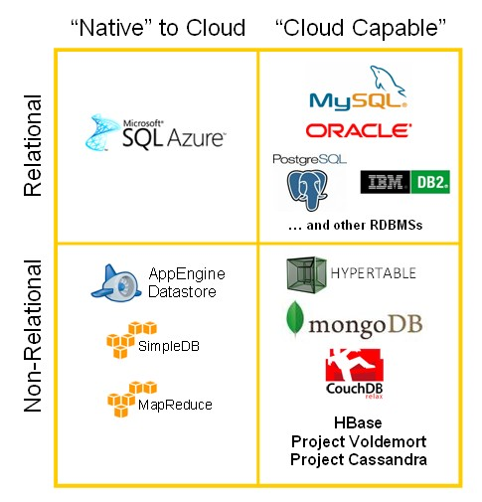

Slide 48
HDFS File system
The HDFS is a distributed, scalable, and portable file system written in Java for the Hadoop framework.
Each node in a Hadoop instance typically has a single datanode; a cluster of datanodes forms the HDFS cluster.
But each node does not require a datanode to be present. Each datanode serves up blocks of data over the network using a block protocol specific to HDFS.
The filesystem uses the TCP/IP layer for communication; clients use RPC to communicate with each other. The HDFS stores large files (an ideal file size is a multiple of 64 MB), across multiple machines.
It achieves reliability by replicating the data across multiple hosts, and hence does not require RAID storage on hosts.
With the default replication value, 3, data is stored on three nodes: two on the same rack, and one on a different rack. Data nodes can talk to each other to rebalance data, to move copies around, and to keep the replication of data high.
The HDFS is not fully POSIX compliant because the requirements for a POSIX filesystem differ from the target goals for a Hadoop application. The tradeoff of not having a fully POSIX compliant filesystem is increased performance for data throughput. The HDFS was designed to handle very large files. The HDFS does not provide high availability.

Slide 49
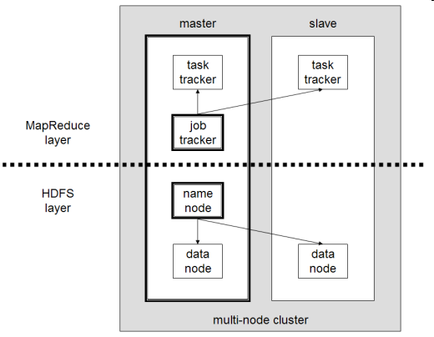
A multinode HADOOP cluster

Slide 50
From T. White, “Hadoop—The definitive guide”
HFDS file permissions provide authorization
Relies on Kerberos for user authentication (passwords)
Authentication produces a Ticket Granting Ticket (TG)
The TGT can be presented to the server for authorization of services
HDFS blocks are not encrypted in storage

Slide 51
Hadoop authentication
<<actor>>
:Client
:Kerberos
Authentication
Server
:Kerberos
TGServer
:Server
get(TGT)
getService(TGT,ST)
getService(ST)

Slide 52
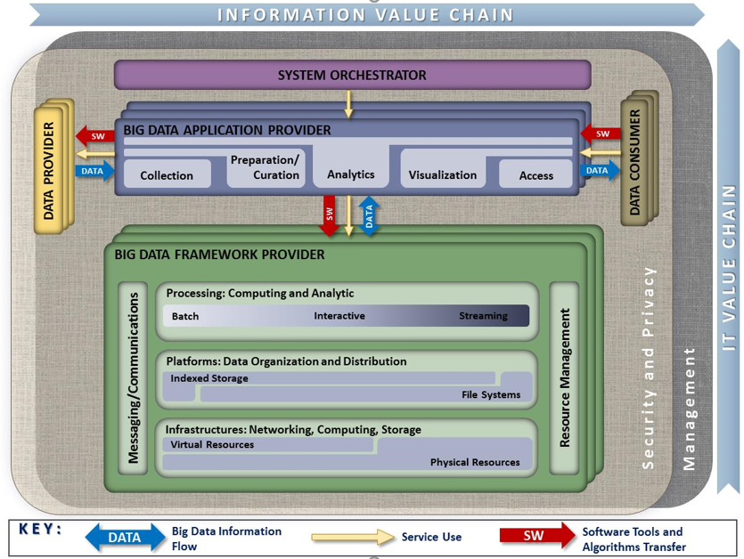
NIST RA
Notes:
General architecture
Taking into account different proposals e.g. Oracle.
Different Components:
System Orchestrator (SO)
Data Provider (DP)
Big Data Application Provider (BDAP)
Big Data Framework Provider (BDFP)
Data Consumer (DC)
Activities and actors

Slide 53
Bruce Schneier schneier@schneier.com http://www.schneier.com
Top three emerging threats in cyberspace.
The Rise of Big Data. By this I mean industries that trade on our data. These include traditional credit bureaus and data brokers, but also data-collection companies like Facebook and Google. They're collecting more and more data about everyone, often without their knowledge and explicit consent, and selling it far and wide: to both other corporate users and to government. Big data is becoming a powerful industry, resisting any calls to regulate its behavior.
Ill-Conceived Regulations from Law Enforcement. We're seeing increasing calls to regulate cyberspace in the mistaken belief that this will fight crime. I'm thinking about data retention laws, Internet kill switches, and calls to eliminate anonymity. None of these will work, and they'll all make us less safe.

Slide 54
Schneier II
The Cyberwar Arms Race. I'm not worried about cyberwar, but I am worried about the proliferation of cyber weapons. Arms races are fundamentally destabilizing, especially when their development can be so easily hidden. I worry about cyberweapons being triggered by accident, cyberweapons getting into the wrong hands and being triggered on purpose, and the inability to reliably trace a cyberweapon leading to increased distrust. Plus, arms races are expensive. That's my list, and they all have the potential to be more dangerous than cybercriminals.

Slide 55
NY Times 10/11/11
More than 60 years ago, in his “Foundation” series, the science fiction novelist Isaac Asimov invented a new science — psychohistory — that combined mathematics and psychology to predict the future.
Now social scientists are trying to mine the vast resources of the Internet — Web searches and Twitter messages, Facebook and blog posts, the digital location trails generated by billions of cellphones — to do the same thing.
The most optimistic researchers believe that these storehouses of “big data” will for the first time reveal sociological laws of human behavior — enabling them to predict political crises, revolutions and other forms of social and economic instability, just as physicists and chemists can predict natural phenomena.
Some social scientists and advocates of privacy rights are deeply skeptical of the project, saying it evokes queasy memories of Total Information Awareness, a post-9/11 Pentagon program that proposed hunting for potential attackers by identifying patterns in vast collections of public and private data: telephone calling records, e-mail, travel data, visa and passport information, and credit card transactions.

Slide 56
More
“These techniques are double-edged,” said Marc Rotenberg, president of the Electronic Privacy Information Center, a privacy rights group based in Washington. “They can be used as easily against political opponents in the United States as they can against threats from foreign countries.”
And some computer scientists expressed skepticism about efforts to predict political instability with indicators like Web searches.
“I’m hard pressed to say that we are witnessing a revolution,” said Prabhakar Raghavan, the director of Yahoo Labs, who is an information retrieval specialist. He noted that much had been written about predicting flu epidemics by looking at Web searches for “flu,” but noted that the predictions did not improve significantly on what could already be found in data from the Centers for Disease Control and Prevention.

Slide 57
References on database security
[Ber05] E. Bertino and R. Sandhu, “Database security—concepts, approaches, and challenges”, IEEE Trans. On Dependable and Secure Computing, vol. 2, No 1, 2005, 2-19.
[Fer75] E.B.Fernandez, R.C.Summers, and T.Lang, “Definition and evaluation of access rules in data management systems”, Procs. First Int. Conf. on Very LargeDatabases, Boston, MA, 1975, 268-285.
E B. Fernandez, Ernest Alder, Richard Bagley, and Swati Paghdar, "A Misuse Pattern for Retrieving Data from a Database Using SQL Injection" , RISE'12,Workshop on Redefining and Integrating Security Engineering, part of the ASE Int. Conf. on Cyber Security, Washington, DC, December 12-14, 2012

